Slide 1

A SEMINAR
On
ARTIFICIAL VISION
Presented by
Sanivada Kanya kumari (19NM5A0414)
Under the Guidance of
Mrs. Ch. S S Jyothirmai
Associate professor
Department of Electronics and Communication Engineering
Vignan’s Institute of Engineering for Women
Affiliated to JNTUK, Visakhapatnam, Andhra Pradesh.

Slide 2
CONTENTS
Introduction
Components required
Working of artificial vision
Another approach to this
Bottle necks raised
Conclusion
References

Slide 3
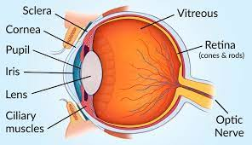
INTRODUCTION
Artificial-vision researchers take inspiration from another device, the cochlear implant(concerned to hearing capability for deaf)
Fig.1.1:Anatomy of eye

Slide 4
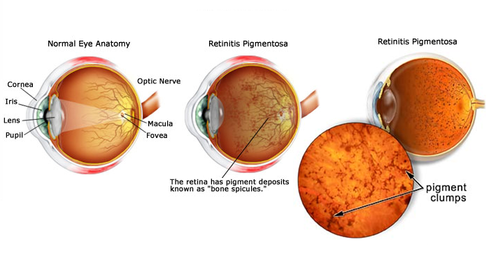
Retina gets damaged due to age related problems leading to degeneration of rods and cones . The diseases that attack the retina are:
Fig. 1.2 Retinitis Pigmentosa, Macular Degeneration
There is no proper cure for these hence we go for Artificial vision system which is a combination of Biotechnology and electronics.

Slide 5
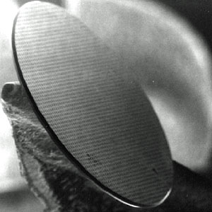
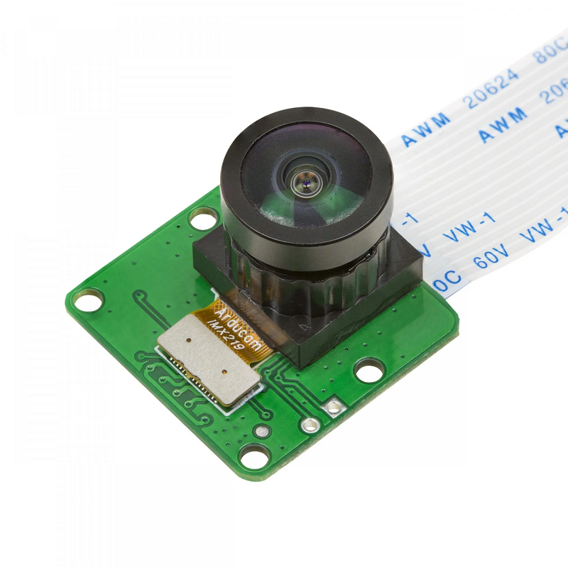
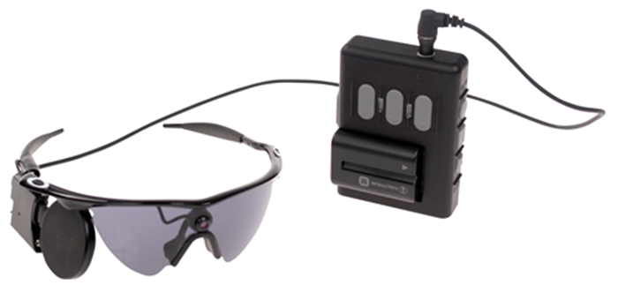
Components of Artificial Vision System
Dr. Mark Humayun demonstrated that a blind person could be made to see light by stimulating the optic nerve behind the retina with an electrical current.
So they have decided to translate images in to electrical pulses that could restore vision artificially.
The major components of this vision system are:
Artificial silicon retina
Miniature video camera
Video processing unit
Infrared LCD screen

Slide 6
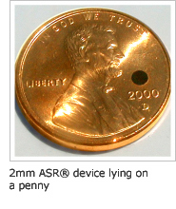
Artificial Silicon Retina(ASR)
ASR is an extremely tiny device. A diameter of just 2mm (.078 inch) and is thinner than a human hair.
By implanting this in to the eye there will not be any damage the other structures.
This has solar cells which attain power from the light falling on over them.
Has solar cells i.e. the photodiodes is used to convert the light in to electrical stimulation and provides to ganglia

Slide 7
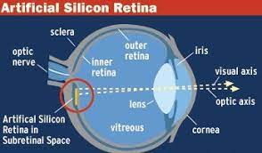
Implantation of Silicon Retina
Implantation includes following steps:
Making 3 tiny incisions in to the white part and cutting through this and remove the gel in the eye.
Then they fill it with saline.
Then make opening in the retina and lift the back portion of the eye.
Then the attain the gap to place the device.

Slide 8
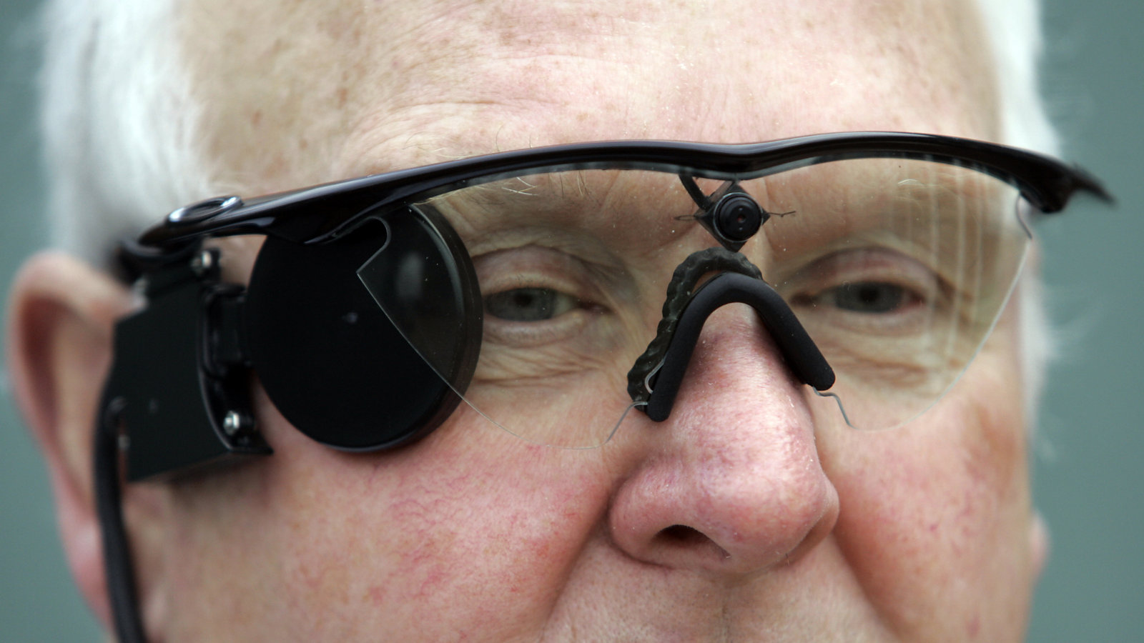
Miniature Video Camera
The camera used for this is CMOS image sensor.
The camera captures the image and converts in to a pixels of black and white.
This camera is placed on the goggles.
The battery required for this is provided from the video processing unit.

Slide 9
Video Processing Unit
Video processing unit acts as a optogenic transducer unit simplifies the image as spots of light and then reduces the image to the number of photodiodes.
This is connected to goggles through router.
This unit majorly consists of
Video decoder
Video scaler
DSP processor
Video processor

Slide 10
Infrared LCD Screen
The infrared converts the attained voltage in to the infrared beam.
This is provided to the electrode array implanted in to the eye.
The electrode array attains the beam when it passes internally in to the eyes.
The LCD screen is majorly used as it consumes less power.
This screen is placed on the goggles.

Slide 11
Working of Artificial Vision System

Slide 12
Image Identification
By using this technology the person can read large letters identify the objects before him. This is useful for retinal diseased people.

Slide 13
Disadvantages
The cost of this equipment is greater it costs $70,000.
This is not applicable for the infants.
It cannot provide crystal clear image but it is useful to identify the object.

Slide 14
Conclusion
As the object size depends on the electrodes or photodiodes utilized the available pixel size will be 100.
Research is going on for high resolution imaging.
However this vision system is break through in the technology.
This is more helpful for the people with macular degeneration and retinitis pigmentosa especially for aged people.

Slide 15
References
www.artificialvision.com
www.howstuffworks.com
www.wikipedia.org

Slide 16
Thank You

